Slide 1
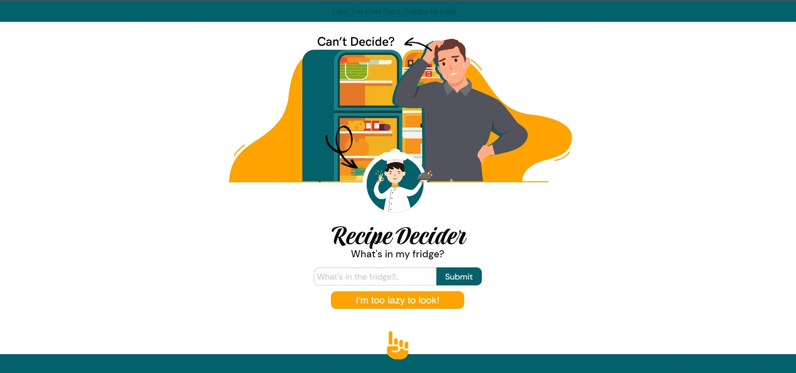
Recipe Decider
by Chef Sam

Slide 2

User Story
As someone who has come home after a long and tiring day of work, I want to get a recipe from ingredients that I have in my fridge without having to go shopping, so that I can solve my hunger issues.

Slide 3

Recipe Decider App
This app is a recipe decider Application that helps you decide what to cook when you come home and don’t know what to prepare.
Tell the app what ingredients you have and the app will present you four unique recipes
If you don’t know what you have in your fridge the app will create random recipes for you.
If you try to fool the app with nonsense the app will list some food movies for you to watch

Slide 4

Concept
Description
A fun app to help you find a recipe
Motivation for development?
Who knows what to cook when they come home? This apps helps you decide.
User story all the user does is look in the fridge and add a few ingredients, the app does the rest.

Slide 5
Process
Technologies used
CSS, Html, JS, Foundation, Git hub, figma illustrator.
Breakdown of tasks and roles
Concept research and development of design, skills recognition and delegation of roles etc.
Developed script design and implementation, API curation and installation.
Challenges included working with a new team and technology.
Successes include collaboration teamwork and a responsive app that works.

Slide 6
Demo
App Video
https://flipper5001.github.io/recipe-decider/

Slide 7
Directions for Future Development
Stage two will develop the app to include
Ingredient online purchasing and delivery integrated system.
Fast food ordering and delivery of healthy food to your door.
Calories counter and exercise ideas.

Slide 8
Links
Deployed
https://flipper5001.github.io/recipe-decider/
GitHub repo
Flipper5001/recipe-decider
Api sources
Spoonacular
Open movie database

Slide 9
Participation
Dan – Html, Readme , Product Research, Wireframing
Filipe - JS, Product Research, Wireframing
May – CSS , Product Research, Wireframing
Vittorio – Html, Product Research, Wireframing, Presentation
These were the core aspects that we worked on, but the project was a collaborative effort with help and guidance across all areas by all participants .

